Slide 1
Basic Concepts of Strategic Management
Chapter 1

Slide 2
Learning Objectives
Understand the benefits of strategic management
Explain how globalization and environmental sustainability influence strategic management
Understand the basic model of strategic management and its components
Notes:
After reading this chapter, you should be able to:
• Understand the benefits of strategic management
• Explain how globalization and environmental sustainability influence strategic management
• Understand the basic model of strategic management and its components

Slide 3
Learning Objectives
Identify some common triggering events that act as stimuli for strategic change
Understand strategic decision-making modes
Use the strategic audit as a method of analyzing corporate functions and activities
Notes:
After reading this chapter, you should be able to:
• Identify some common triggering events that act as stimuli for strategic change
• Understand strategic decision-making modes
• Use the strategic audit as a method of analyzing corporate functions and activities

Slide 4
The Study of Strategic Management
Strategic Management
a set of managerial decisions and actions that determines the long-run performance of a corporation
Notes:
Strategic management is a set of managerial decisions and actions that help determine the long-term performance of an organization.

Slide 5
The Study of Strategic Management
Strategic Management includes:
Internal and external environment scanning
Strategy formulation
Strategy implementation
Evaluation and control
Notes:
Strategic management includes environmental scanning (both external and internal), strategy formulation (strategic or long-range planning), strategy implementation and evaluation and control.

Slide 6
Phases of Strategic Management
Phase 1: Basic financial planning
Phase 2: Forecast-based planning
Phase 3: Externally oriented strategic planning
Phase 4: Strategic management
Notes:
As managers attempt to better deal with their changing world, a firm generally evolves through the following four phases of strategic management:
Phase 1: Basic financial planning
Phase 2: Forecast-based planning
Phase 3: Externally oriented strategic planning
Phase 4: Strategic management

Slide 7
Benefits of Strategic Management
The attainment of an appropriate match, or “fit,” between an organization’s environment and its strategy, structure and processes has positive effects on the organization’s performance.
Strategic planning becomes increasingly important as the environment becomes more unstable.
Notes:
The attainment of an appropriate match, or “fit,” between an organization’s environment and its strategy, structure and processes has positive effects on the organization’s performance. Strategic planning becomes increasingly important as the environment becomes more unstable

Slide 8
Benefits of Strategic Management
Clearer sense of strategic vision for the firm
Sharper focus on what is strategically important
Improved understanding of a rapidly changing environment
Notes:
A survey of nearly 50 corporations in a variety of countries and industries found the three most highly rated benefits of strategic management to be:
■ A clearer sense of strategic vision for the firm.
■ A sharper focus on what is strategically important.
■ An improved understanding of a rapidly changing environment.

Slide 9
Impact of Globalization
Globalization
the integrated internationalization of markets and corporations
has changed the way modern corporations do business
Notes:
Globalization, the integrated internationalization of markets and corporations, has changed the way modern corporations do business.

Slide 10
Impact of Innovation
Innovation
describes new products, services, methods and organizational approaches that allow the business to achieve extraordinary returns
Innovation is the implementation of potential innovations that truly drives businesses to be remarkable.
Notes:
Innovation, as the term is used in business, is meant to describe new products, services, methods and organizational approaches that allow the business to achieve extraordinary returns. Innovation is the machine that generates business opportunities in the market; however, it is the implementation of potential innovations that truly drives businesses to be remarkable.

Slide 11
Impact of Sustainability
Sustainability
refers to the use of business practices to manage the triple bottom line
Notes:
Sustainability refers to the use of business practices to manage the triple bottom line.

Slide 12
Impact of Sustainability
The triple bottom line involves:
the management of traditional profit/loss;
the management of the company’s social responsibility; and
the management of its environmental responsibility.
Notes:
That triple bottom line involves (1) the management of traditional profit/loss; (2) the management of the company’s social responsibility; and (3) the management of its environmental responsibility.

Slide 13
Theories of Organizational Adaptation
Population ecology
once an organization is successfully established in a particular environmental niche, it is unable to adapt to changing conditions
Institution theory
organizations can and do adapt to changing conditions by imitating other successful organizations
Notes:
The theory of population ecology suggests that once an organization is successfully established in a particular environmental niche, it is unable to adapt to changing conditions. Inertia prevents the organization from changing in any significant manner. Institution theory, in contrast, proposes that organizations can and do adapt to changing conditions by imitating other successful organizations.

Slide 14
Theories of Organizational Adaptation
Strategic choice perspective
not only do organizations adapt to a changing environment, but they also have the opportunity and power to reshape their environment
Notes:
The strategic choice perspective goes one step further by proposing that not only do organizations adapt to a changing environment, but they also have the opportunity and power to reshape their environment.

Slide 15
Theories of Organizational Adaptation
Organizational learning theory
an organization adjusts defensively to a changing environment and uses knowledge offensively to improve the fit between itself and its environment
Notes:
Because of its emphasis on managers making rational strategic decisions, the strategic choice perspective is the dominant one taken in strategic management. Its argument that adaptation is a dynamic process fits with the view of organizational learning theory, which says that an organization adjusts defensively to a changing environment and uses knowledge offensively to improve the fit between itself and its environment.

Slide 16
Creating a Learning Organization
Strategic flexibility
the ability to shift from one dominant strategy to another and requires:
Long-term commitment to the development and nurturing of critical resources
Learning organization
Notes:
Corporations must develop strategic flexibility—the ability to shift from one dominant strategy to another. Strategic flexibility demands a long-term commitment to the development and nurturing of critical resources. It also demands that the company become a learning organization.

Slide 17
Creating a Learning Organization
Learning organization
an organization skilled at creating, acquiring and transferring knowledge and at modifying its behavior to reflect new knowledge and insights
Organizational learning is a critical component of competitiveness in a dynamic environment.
Notes:
A learning organization is an organization skilled at creating, acquiring and transferring knowledge and at modifying its behavior to reflect new knowledge and insights. Organizational learning is a critical component of competitiveness in a dynamic environment.

Slide 18
Creating a Learning Organization
Learning organizations are skilled at four main activities:
Solving problems systematically
Experimenting with new approaches
Learning from their own experiences and past history as well as from the experiences of others
Transferring knowledge quickly and efficiently throughout the organization
Notes:
Learning organizations are skilled at four main activities:
■ Solving problems systematically
■ Experimenting with new approaches
■ Learning from their own experiences and past history as well as from the experiences of others
■ Transferring knowledge quickly and efficiently throughout the organization

Slide 19
Basic Model of Strategic Management
Strategic management consists of four basic elements:
Environmental scanning
Strategy formulation
Strategy implementation
Evaluation and control
Notes:
Strategic management consists of four basic elements:
■ Environmental scanning
■ Strategy formulation
■ Strategy implementation
■ Evaluation and control

Slide 20
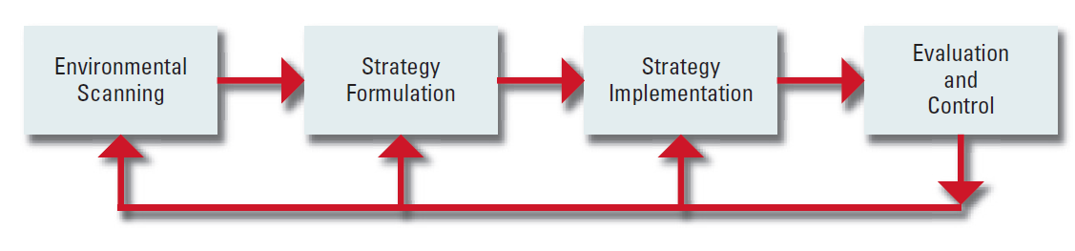
Basic Elements of the Strategic Management Process
Figure 1-1
Notes:
Figure 1–1 illustrates how these four elements interact

Slide 21
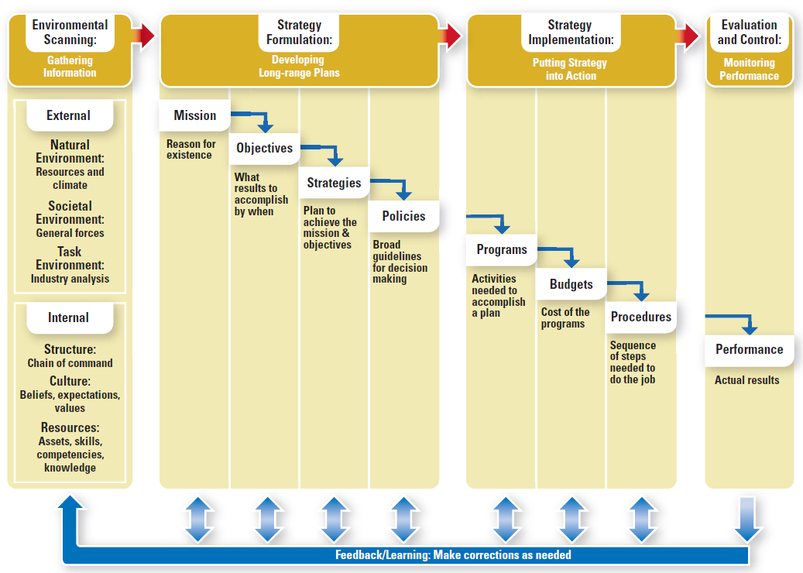
Strategic Management Model
Figure 1-2
Notes:
Figure 1–2 expands each of these elements and serves as the model for this book. This model is both rational and prescriptive.

Slide 22
Basic Model of Strategic Management
Environmental scanning
the monitoring, evaluating and disseminating of information from the external and internal environments to key people within the organization
SWOT analysis
Notes:
Environmental scanning is the monitoring, evaluating and disseminating of information from the external and internal environments to key people within the corporation. Its purpose is to identify strategic factors—those external and internal elements that will assist in the analysis in deciding the strategic decisions of the corporation. The simplest way to conduct environmental scanning is through SWOT analysis.

Slide 23
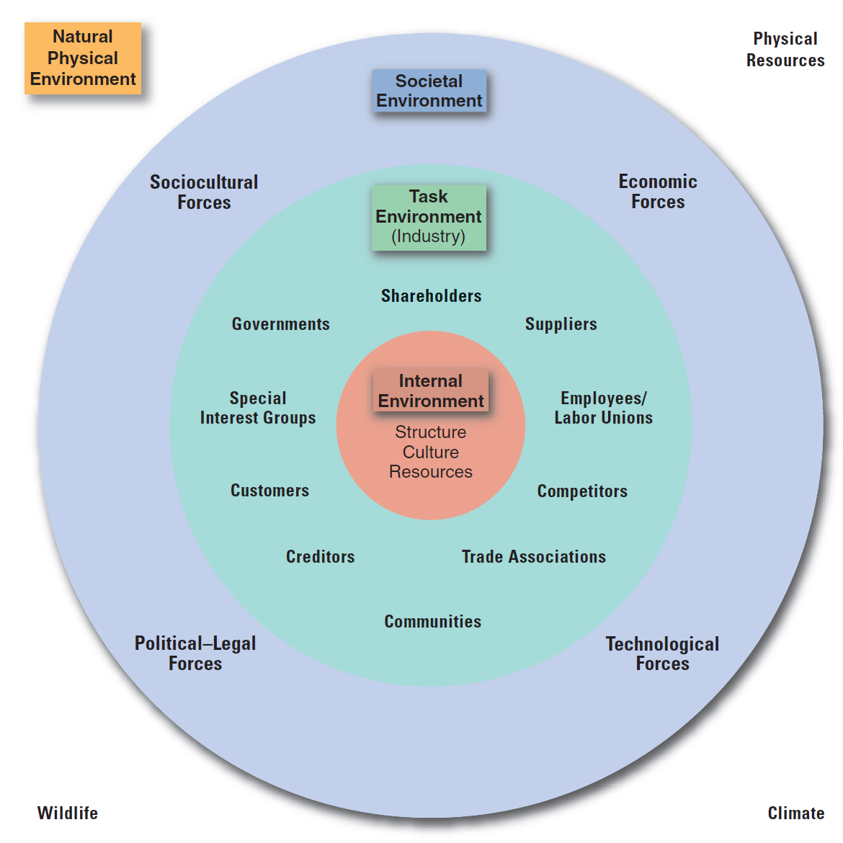
Environmental Variables
Figure 1-3
Notes:
Figure 1–3 depicts key environmental variables. They may be general forces and trends within the natural or societal environments or specific factors that operate
within an organization’s specific task environment—often called its industry.

Slide 24
Basic Model of Strategic Management
Strategy formulation
process of investigation, analysis and decision making that provides the company with the criteria for attaining a competitive advantage
includes defining the competitive advantages of the business (Strategy), crafting the corporate mission, specifying achievable objectives and setting policy guidelines.
Notes:
Strategy formulation is the process of investigation, analysis and decision making that provides the company with the criteria for attaining a competitive advantage. It includes defining the competitive advantages of the business (Strategy), crafting the corporate mission, specifying achievable objectives and setting policy guidelines.

Slide 25
Basic Model of Strategic Management
Mission
the purpose or reason for the organization’s existence
Vision
describes what the organization would like to become
Objectives
the end results of planned activity
Notes:
An organization’s mission is the purpose or reason for the organization’s existence. Some people like to consider vision and mission as two different concepts: Mission describes what the organization is now; vision describes what the organization would like to become. Objectives are the end results of planned activity. They should be stated as action verbs and tell what is to be accomplished by when and quantified if possible.

Slide 26
Basic Model of Strategic Management
Strategy
forms a comprehensive master approach that states how the corporation will achieve its mission and objectives
maximizes competitive advantage and minimizes competitive disadvantage
corporate, business, functional
Notes:
A strategy of a corporation forms a comprehensive master approach that states how the corporation will achieve its mission and objectives. It maximizes competitive advantage and minimizes competitive disadvantage. Corporate strategy describes a company’s overall direction in terms of its general attitude toward growth and the management of its various businesses and product lines. Business strategy usually occurs at the business unit or product level, and it emphasizes improvement of the competitive position of a corporation’s products or services. in the specific industry or market segment served by that business unit. Functional strategy is the approach taken by a functional area to achieve corporate and business unit objectives and strategies by maximizing resource productivity.

Slide 27
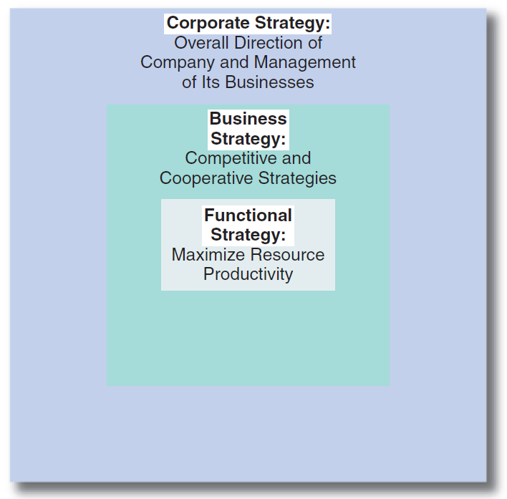
Hierarchy of Strategy
Notes:
A hierarchy of strategy is a grouping of strategy types by level in the organization. Hierarchy of strategy is a nesting of one strategy within another so that they complement and support one another. (See Figure 1–4.) Functional strategies support business strategies, which, in turn, support the corporate strategy(ies).

Slide 28
Basic Model of Strategic Management
Policy
a broad guideline for decision making that links the formulation of a strategy with its implementation
Notes:
A policy is a broad guideline for decision making that links the formulation of a strategy with its implementation.

Slide 29
Basic Model of Strategic Management
Strategy implementation
a process by which strategies and policies are put into action through the development of programs, budgets and procedures
Notes:
Strategy implementation is a process by which strategies and policies are put into action through the development of programs, budgets and procedures.

Slide 30
Basic Model of Strategic Management
Evaluation and control
a process in which corporate activities and performance results are monitored so that actual performance can be compared with desired performance
Notes:
Evaluation and control is a process in which corporate activities and performance results are monitored so that actual performance can be compared with desired performance.

Slide 31
Basic Model of Strategic Management
Performance
the end result of organizational activities
includes the actual outcomes of the strategic management process
Feedback/Learning process
revise or correct decisions based on performance
Notes:
Performance is the end result of activities. It includes the actual outcomes of the strategic management process. As a firm or business unit develops strategies, programs and the like, it often must go back to revise or correct decisions made earlier in the process.

Slide 32
Initiation of Strategy: Triggering Events
Triggering event
something that acts as a stimulus for a change in strategy and can include:
New CEO
External intervention
Threat of change of ownership
Performance gap
Strategic inflection point
Notes:
A triggering event is something that acts as a stimulus for a change in strategy. Some possible triggering events are: new CEO, external intervention, threat of change of ownership, performance gap and strategic inflection point.

Slide 33
Strategic Decision Making
Strategic decisions
deal with the long-term future of an entire organization and have three characteristics:
Rare
Consequential
Directive
Notes:
Unlike many other decisions, strategic decisions deal with the long-term future of an entire organization and have three characteristics: rare, consequential, and directive

Slide 34
Three Characteristics of Strategic Decisions
Rare
Strategic decisions are unusual and typically have no precedent to follow.
Consequential
Strategic decisions commit substantial resources and demand a great deal of commitment from people at all levels.
Directive
Strategic decisions set precedents for lesser decisions and future actions throughout an organization
Notes:
The three characteristics of strategic decisions are:
1. Rare: Strategic decisions are unusual and typically have no precedent to follow.
2. Consequential: Strategic decisions commit substantial resources and demand a great deal of commitment from people at all levels.
3. Directive: Strategic decisions set precedents for lesser decisions and future actions throughout an organization

Slide 35
Mintzberg’s Modes of Strategic Decision Making
Entrepreneurial
Adaptive
Planning
Logical incrementalism
Notes:
According to Henry Mintzberg, the three most typical approaches, or modes, of strategic decision making are entrepreneurial, adaptive and planning (a fourth mode, logical incrementalism, was added later by Quinn)

Slide 36
Strategic Decision-Making Process
Evaluate current performance results
Review corporate governance
Scan and assess the external environment
Scan and assess the internal corporate environment
Analyze strategic (SWOT) factors
Generate, evaluate and select the best alternative strategy
Implement selected strategies
Evaluate implemented strategies
Notes:
Research indicates that the planning mode is not only more analytical and less political than are the other modes, but it is also more appropriate for dealing with complex, changing environments. We therefore propose the following eight-step strategic decision-making process to improve the making of strategic decisions
Evaluate current performance results
Review corporate governance
Scan and assess the external environment
Scan and assess the internal corporate environment
Analyze strategic (SWOT) factors
Generate, evaluate and select the best alternative strategy
Implement selected strategies
Evaluate implemented strategies

Slide 37
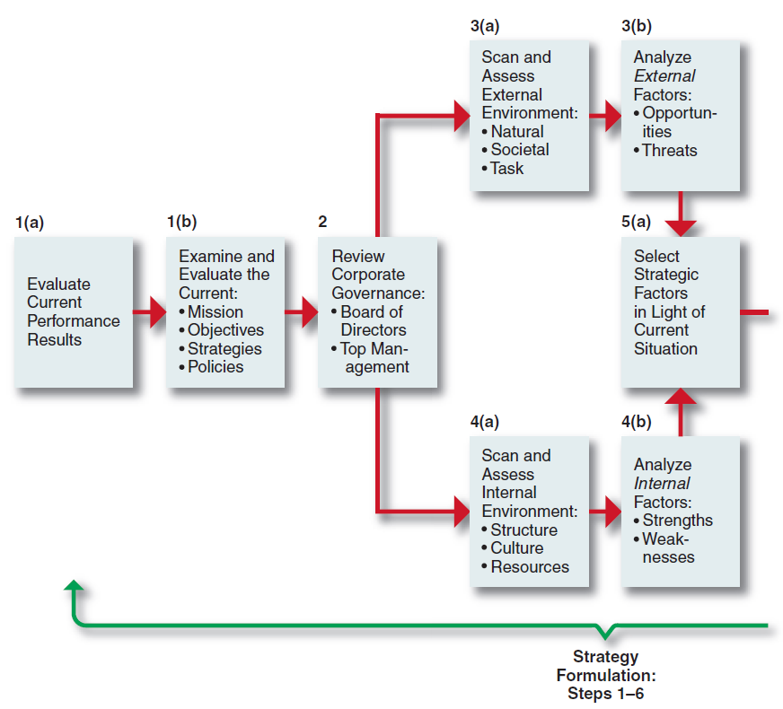
Strategic Decision-Making Process
Figure 1-5
Notes:
Figure 1–5 illustrates an eight-step strategic decision-making process to improve the making of strategic decisions.

Slide 38
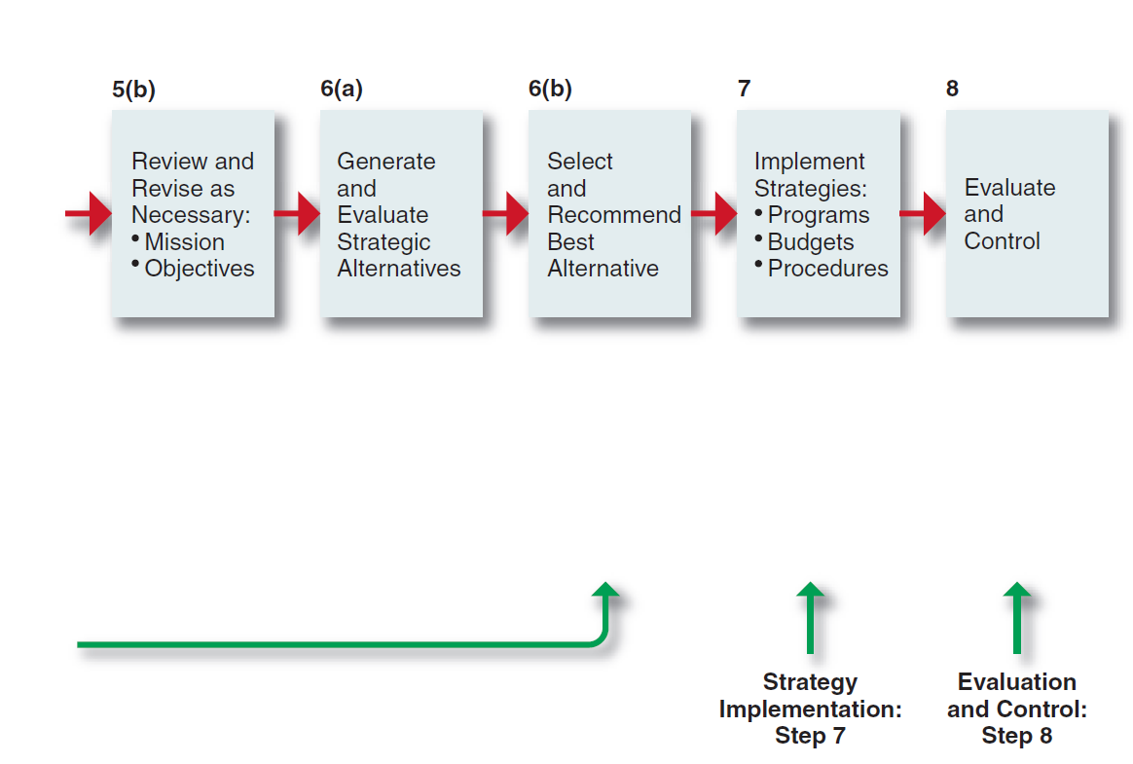
Strategic Decision-Making Process
Figure 1-5
Notes:
Figure 1–5 illustrates an eight-step strategic decision-making process to improve the making of strategic decisions.

Slide 39
The Strategic Audit: Aid to Strategic Decision Making
Strategic audit
provides a checklist of questions, by area or issue, that enables a systematic analysis to be made of various corporate functions and activities
Notes:
A strategic audit provides a checklist of questions, by area or issue, that enables a systematic analysis to be made of various corporate functions and activities.

